Slide 1
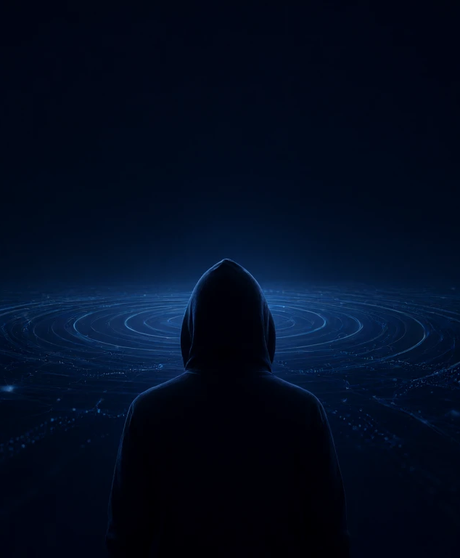
Digital Privacy, OPSEC & AI-Era OSINT
Mohammad Abbasnejad
2026

Slide 2

WHY SHOULD WE EVEN CARE?
Your Data Is Already a Product
17B
~1B
location signals per day
mobile devices
FTC complaint: alleged volume processed by Gravy Analytics
FTC complaint: alleged location-data scale
Trails can reveal visits to medical, religious, and political sites.
The FTC alleged these data were sold and could identify consumers.
Exposure can become a safety issue—not just an advertising preference.
2
Notes:
Pacing: 75 seconds. Stress that these are allegations described by the FTC, not a general measure of every broker. The FTC said location data tied to sensitive places could expose health decisions, religious practices, and political activity; this makes the privacy question concrete.
Sources:
- FTC, Gravy Analytics and Venntel location-data enforcement announcement (2024-12) — https://www.ftc.gov/news-events/news/press-releases/2024/12/ftc-takes-action-against-gravy-analytics-venntel-unlawfully-selling-location-data-tracking-consumers

Slide 3





WHY SHOULD WE EVEN CARE?
Five Ways Leaked Data Becomes Real Harm
Identity theft
Data brokers
Targeted social engineering
Exposed identifiers can aid impersonation and account-recovery fraud.
Location and activity records can be aggregated, sold, and repurposed.
Personal details make believable pretexts easier to build.
Profiling
Irreversibility
Routine signals can infer interests, routines, and sensitive affiliations.
Copied or linked information may persist after the original is deleted.
3
Notes:
Pacing: 80 seconds. Explain these as mechanisms, not guaranteed outcomes. FTC enforcement describes location data linked to sensitive places; Microsoft reports that adversaries research targets and use social engineering. A published clue can be copied, cached, and joined with other records, so deleting the original may not undo every copy.
Sources:
- FTC, Gravy Analytics and Venntel location-data enforcement announcement (2024-12) — https://www.ftc.gov/news-events/news/press-releases/2024/12/ftc-takes-action-against-gravy-analytics-venntel-unlawfully-selling-location-data-tracking-consumers
- Microsoft Digital Defense Report 2024 (2024-10) — https://cdn-dynmedia-1.microsoft.com/is/content/microsoftcorp/microsoft/final/en-us/microsoft-brand/documents/Microsoft%20Digital%20Defense%20Report%202024%20%281%29.pdf

Slide 4
OPSEC FOUNDATION
Privacy ≠ Anonymity — Know Your Threat Model
Privacy
Anonymity
Control who can access your information and activity.
Reduce how readily activity can be linked to your real identity.
Examples: end-to-end encryption, data minimization, restrictive sharing.
Examples: separate personas, reduce identifiers, avoid cross-context logins.
Start with: who are you protecting against, what do they know, and what harm matters most?
4
Notes:
Pacing: 70 seconds. Privacy and anonymity overlap but are not interchangeable: encrypted content may still leave metadata, and anonymous browsing does not protect data you disclose in an account. Threat-model by asset, adversary capability, and consequence; avoid claiming protection from every actor.
Sources:
- Microsoft Digital Defense Report 2024 (2024-10) — https://cdn-dynmedia-1.microsoft.com/is/content/microsoftcorp/microsoft/final/en-us/microsoft-brand/documents/Microsoft%20Digital%20Defense%20Report%202024%20%281%29.pdf

Slide 5


NETWORK DEFENSE
VPN, Tor, Mullvad: Pick the Right Pipe
VPN
Tor
Mullvad Browser
Shifts trust from your ISP to the provider. Prefer audited, RAM-only, no-logs services.
Stronger anonymity, slower, sometimes blocked. Avoid casual VPN+Tor stacking.
Fingerprint-uniform browser built with the Tor Project — for everyday browsing.
5
Notes:
Pacing: 75 seconds. Be honest about trade-offs: a VPN relocates trust rather than removing it; Tor is stronger against correlation but slower. Mullvad Browser is for blending in on the clearnet. Mention DNS-over-HTTPS and disabling WebRTC as concrete leak-prevention steps.
Sources:
- Mullvad Browser (2026) — https://mullvad.net/en/browser
- Tor Project official guidance (via Privacy Guides discussion) (2024) — https://discuss.privacyguides.net/t/should-i-use-tor-over-a-vpn-or-simply-use-a-bridge/32922

Slide 6
ENVIRONMENT HARDENING
Compartmentalize: Never Mix Contexts
1
2
3
4
Everyday profiles
Isolated VMs
Whonix (VM)
Tails (live USB)
Separate browsers and profiles; enough for everyday persona separation.
One VM per persona; the host's identity stays outside the VM.
All workstation traffic routed through a Tor gateway VM.
Live, amnesic system; leaves no trace on the host disk.
6
Notes:
Pacing: 70 seconds. Frame as escalating levels of isolation, not a required ladder — the harder the isolation, the more friction. Whonix routes all workstation traffic through a Tor gateway; Tails is amnesic and boots from USB. The core principle: contexts never share cookies, credentials, or network identity.
Sources:
- Whonix Documentation: Comparison with Others (2026-05) — https://www.whonix.org/wiki/Comparison_with_Others

Slide 7
FINGERPRINTING
Your Browser Fingerprint Gives You Away
What makes you unique
How to reduce it
Use Tor Browser for anonymity routing and a uniform fingerprint.
Canvas, WebGL, and audio rendering results.
Use Mullvad Browser for everyday browsing with uniform settings.
Installed fonts, plugins, screen size, and time zone.
Avoid many extensions or deep customization.
User-agent, OS, and extension combinations.
Test at EFF Cover Your Tracks: coveryourtracks.eff.org.
7
Notes:
Pacing: 70 seconds. Fingerprinting works because browsers are slightly different; the 2018 study found 33.6% unique fingerprints in one dataset and 89.4% in another. Private mode does not change the fingerprint. Uniformity is the defense offered by Tor Browser and Mullvad Browser.
Sources:
- Gómez-Boix et al., 'An Analysis of the Effectiveness of Browser Fingerprinting' (WWW '18) (2018) — https://dl.acm.org/doi/fullHtml/10.1145/3178876.3186097
- EFF Cover Your Tracks (2026) — https://coveryourtracks.eff.org/
- Mullvad Browser (2026) — https://mullvad.net/en/browser

Slide 8



Privacy in the Age of Generative AI
Treat every AI interaction as a potential data disclosure
Prompts are data
Training & retention
Telemetry persists
Keep secrets, client records, and identifying details out of public assistants.
Check whether chats are stored, reviewed, or used to improve models.
Usage logs and account metadata can reveal more than the prompt.
Prompt injection
Private alternatives
Untrusted content may steer tools toward exposed data.
Use local Ollama models; isolate or air-gap systems for sensitive work.
8
Notes:
Distinguish model training from service retention: provider policies and controls vary, so verify settings for the specific product. Local inference can reduce third-party exposure, but it does not secure a compromised device or automatically prevent logging; prompt injection is a risk whenever models process untrusted content or have tool access.
Sources:
- OpenAI Privacy Policy (n.d.) — https://openai.com/policies/privacy-policy/
- Ollama Documentation (n.d.) — https://docs.ollama.com/
- OWASP GenAI Security Project — Prompt Injection (n.d.) — https://genai.owasp.org/llmrisk/llm01-prompt-injection/

Slide 9
Next-Gen OSINT in the AI Era
AI makes cross-platform identity correlation faster—not inevitable
Face search
Search public images by face, e.g. PimEyes.
Countermeasures
Multimodal linking
Limit face/voice exposure; split personas; strip metadata.
Correlation
Photos, names, places and times reinforce each other.
Small public clues can become a linked identity
Voice cloning
AI stylometry
Cloned voices demand verification through another channel.
Writing style can connect accounts; leads, not proof.
9
Notes:
Emphasize that AI-assisted matching can produce false positives and should not be treated as definitive identification. PimEyes is an example of face-search technology, not a guarantee that every image can be found. Defensive measures focus on reducing exposed signals and independently verifying high-impact claims.
Sources:
- PimEyes (n.d.) — https://pimeyes.com/en
- NIST Face Recognition Technology (n.d.) — https://www.nist.gov/itl/iad/image-group/face-recognition-technology-frt

Slide 10
Behavior Beats Tools
Privacy and OPSEC are habits—especially when AI makes correlation cheap.
Reduce one exposure. Verify, then trust.

